Slide 2
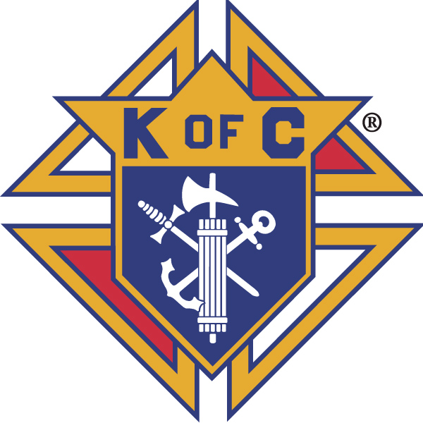
The Knights of Columbus was established on March 29, 1882, in New Haven Connecticut.

Slide 3
The Principles of the Knights of Columbus are Charity, Unity and Fraternity.

Slide 4
The Fourth Degree was established on February 22, 1900, on the principle of patriotism.

Slide 5
The Supreme Assembly is the governing body and is composed of the Supreme Master Dennis Stoddard, the Supreme Knight Dennis Kelly, the Supreme Secretary Patrick Mason and 20 Vice Supreme Masters.

Slide 6
The Calvert Province covers Delaware, District of Columbia, Maryland, Pennsylvania and Virginia for the Knights of Columbus Fourth Degree Members

Slide 7
The Calvert Province is one of the original 6 provinces established by the Knights of Columbus

Slide 8
Calvert Province has 7 Districts
Archdiocese of Washington
Delaware
Maryland
Pennsylvania Central
Pennsylvania East,
Pennsylvania West
Virginia

Slide 9
Cardinal Dougherty Assembly is part of the Pennsylvania East District led by Master Jim McCarthy.

Slide 10
On May 26, 1920, during a meeting at the Knights of Columbus Home at 38th & Market Streets in Philadelphia. The decision was made to form a new Assembly.

Slide 11
The Assembly was named
Archbishop Dougherty Assembly
Honoring the current
Archbishop of Philadelphia

Slide 12
The original councils were
Americus 242
West Philadelphia 344
De La Salle 590
Pinzon 904
Columbus 994
Msgr. Henry C. Schuyler 1333

Slide 13
Sir Knight B. J. Morrison of Pinzon Council was elected as the 1st Navigator.

Slide 14
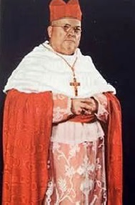
About Dennis Joseph Cardinal Dougherty

Slide 15
Dennis Joseph Dougherty was born August 16, 1865, in Honesdale, Schuylkill County, Pennsylvania.

Slide 16
Cardinal Dougherty was the son of Patrick and Bridget Dougherty from County Mayo, Ireland

Slide 17
On April 30, 1918, Archbishop Dougherty succeeded his friend, Archbishop Edmond Prendergast as Archbishop of Philadelphia.

Slide 18
The earliest home for the Assembly was the Knights of Columbus Hall located at 38th and Market Streets in Philadelphia.

Slide 19
On March 7, 1921, Archbishop Dougherty was Created Cardinal by Pope Benedict XV.

Slide 20
Shortly afterwards, the Assembly name was changed to
Cardinal Dougherty Assembly.

Slide 21
Cardinal Dougherty died on May 31, 1951 and was buried in Philadelphia.

Slide 22
In 1961, under the leadership of Navigator John J. Dugan, the site was changed to De La Salle Council Home in Springfield where they met for many years.

Slide 23
In 1980, Chester County Assembly was formed from the Councils in Chester County, who were formerly under the jurisdiction of Cardinal Dougherty Assembly.

Slide 24
In 2010, Father Emil Kapaun Assembly was formed from the Councils in Western Delaware County, who were formerly under the jurisdiction of Cardinal Dougherty Assembly.

Slide 25
The Assembly met in local restaurants for a few years. In 2016, under the leadership of Navigator Neal Pizzano, the Conclave was moved to Peace Council in Ridley where it still meets.

Slide 26
In 2016, Father Atkinson, OSA Assembly was formed from the Councils in the Upper Darby and Havertown areas who were formerly under the jurisdiction of Cardinal Dougherty Assembly.

Slide 27
.
A Program to provide Memorial contributions to honor departed Sir Knights was instituted soon after the Assembly was formed.

Slide 28
.
Cardinal Dougherty Assembly honors our deceased at a Memorial Mass each November.

Slide 29
.
Cardinal Dougherty Assembly supports our Seminarians through the RSVP Program..

Slide 30
Cardinal Dougherty Assembly Color Corps participates at many events supporting our Parishes, Local Communities, Veterans Organizations and the Archdiocese of Philadelphia

Slide 31
The Knights Helping Knights Program has been set up to help Brother Sir Knights in need.
.

Slide 32
.
Cardinal Dougherty Assembly supports our youth through the
Catholic Committee on Scouting.

Slide 33
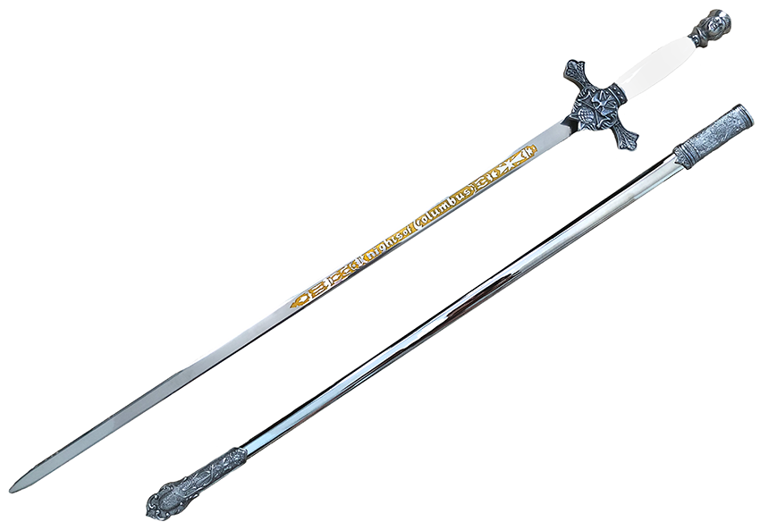
Cardinal Dougherty Medal

Slide 34
The most prestigious award given by the Assembly is the Cardinal Dougherty Medal. Recipients of the Cardinal Dougherty are:
Sir Knight James Warne, OSA

Slide 35
The most prestigious award given by the Assembly is the Cardinal Dougherty Medal. Recipients of the Cardinal Dougherty are:
Sir Knight William Harper - PSD, FVSM

Slide 36
The most prestigious award given by the Assembly is the Cardinal Dougherty Medal. Recipients of the Cardinal Dougherty are:
SK Carmine J. Martorelli - FSW, FM, PFN

Slide 37
The most prestigious award given by the Assembly is the Cardinal Dougherty Medal. Recipients of the Cardinal Dougherty are:
Sir Knight Peter Driscoll - PFN

Slide 38
The most prestigious award given by the Assembly is the Cardinal Dougherty Medal. Recipients of the Cardinal Dougherty are:
Sir Knight John Cruice - PFN, FDD

Slide 39
The most prestigious award given by the Assembly is the Cardinal Dougherty Medal. Recipients of the Cardinal Dougherty are:
SK Gerard Paradis - PFN

Slide 40
The most prestigious award given by the Assembly is the Cardinal Dougherty Medal. Recipients of the Cardinal Dougherty are:
SK Aaron Cubbage - PSD, FM

Slide 41
The most prestigious award given by the Assembly is the Cardinal Dougherty Medal. Recipients of the Cardinal Dougherty are:
SK Reverend Dennis Weber SdC,
Former State Chaplain, Faithful Friar

Slide 42
The most prestigious award given by the Assembly is the Cardinal Dougherty Medal. Recipients of the Cardinal Dougherty are:
SK Benjamin J. Linowski, Jr – PFN, FDD

Slide 43
The most prestigious award given by the Assembly is the Cardinal Dougherty Medal. Recipients of the Cardinal Dougherty are:
SK John Cruice, Jr – PFN, FDD

Slide 44
The most prestigious award given by the Assembly is the Cardinal Dougherty Medal. Recipients of the Cardinal Dougherty are:
SK Patrick McFadden – PFN, FDD

Slide 45
The most prestigious award given by the Assembly is the Cardinal Dougherty Medal. Recipients of the Cardinal Dougherty are:
SK Charles Cunningham - PFN, FDD

Slide 46
The most prestigious award given by the Assembly is the Cardinal Dougherty Medal. Recipients of the Cardinal Dougherty are:
SK Neal Pizzano – PFN, PGK

Slide 47
The most prestigious award given by the Assembly is the Cardinal Dougherty Medal. Recipients of the Cardinal Dougherty are:
SK Fran O’Hara – FSW, PFN

Slide 48
The most prestigious award given by the Assembly is the Cardinal Dougherty Medal. Recipients of the Cardinal Dougherty are:
SK Harry Mirra – PGK

Slide 49
The most prestigious award given by the Assembly is the Cardinal Dougherty Medal. Recipients of the Cardinal Dougherty are:
SK Joseph Paoletti - FST, FM

Slide 50
State Officers from Cardinal Dougherty Assembly

Slide 51
Seven Sir Knights of Cardinal Dougherty Assembly were elected as State Officers
State Warden Charles Shillingford
De La Salle Council 590

Slide 52
Seven Sir Knights of Cardinal Dougherty Assembly were elected as State Officers
State Warden Carmen Martorelli
Marian Council 3753

Slide 53
Seven Sir Knights of Cardinal Dougherty Assembly were elected as State Officers
State Treasurer Jack Horan
Peace Council 4518

Slide 54
Seven Sir Knights of Cardinal Dougherty Assembly were elected as State Officers
State Advocate Mike Gilfedder
De La Salle Council 590

Slide 55
Seven Sir Knights of Cardinal Dougherty Assembly were elected as State Officers
State Treasurer Joe Caromano
Mater Dei Council 4129

Slide 56
Seven Sir Knights of Cardinal Dougherty Assembly were elected as State Officers
State Secretary Dan Eury
Mater Dei Council 4129

Slide 57
Seven Sir Knights of Cardinal Dougherty Assembly were elected as State Officers
State Deputy Ron Cubbage
De La Salle Council 590

Slide 58
Seven Sir Knights of Cardinal Dougherty Assembly were elected as State Officers
State Secretary Rick Terroni
Mater Dei Council 4129

Slide 59
Seven Sir Knights of Cardinal Dougherty Assembly were elected as State Officers
State Warden Fran O’Hara
Peace Council 4518

Slide 60
Seven Sir Knights of Cardinal Dougherty Assembly were elected as State Officers
State Treasurer Joe Paoletti
De La Salle Council 590

Slide 61
Worthy Masters from Cardinal Dougherty Assembly

Slide 62
Five Sir Knights from our Assembly have attained the position of Master.
SK Frank J. Eustace, Jr., Esq.
1958 -1962
Columbus Council 992

Slide 63
Five Sir Knights from our Assembly have attained the position of Master.
SK Carmine J. Martorelli
1976 - 1978
Marian Council 3753

Slide 64
Five Sir Knights from our Assembly have attained the position of Master.
S.K. Frederick H. Seidenburg
1978 - 1980
Peace 4518 / Holmesburg 1284

Slide 65
Five Sir Knights from our Assembly have attained the position of Master.
SK Aaron Cubbage, PSD
2004 – 2008
De La Salle Council 590

Slide 66
Five Sir Knights from our Assembly have attained the position of Master.
SK Joseph Paoletti, FST
2020 – 2022
De La Salle Council 590

Slide 67
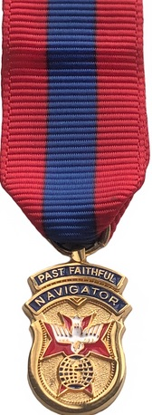
Cardinal Dougherty Assembly Navigators

Slide 68
Sir Knight Mike Yuknek is the 81st Navigator of Cardinal Dougherty Assembly. Previous Navigators are listed next.

Slide 69
Navigators 1920 - 1939
*SK J. B. Morrison 1920 - 1921
*SK J. B. Dougherty 1921 - 1923
*SK B. J. Martin 1923 - 1926
*SK Dr. Joseph P. Garvey 1926 - 1927
*SK Cyril E. Dolan 1927 - 1928
*SK John J. Buckley 1929 - 1932
*SK Joseph B. Hearn 1932 - 1934
*SK Francis J. Eustace, Esq., FM 1934 - 1937
*SK Robert A. Lange 1937 - 1938
*SK A. J. Bruton 1938 - 1939
* Deceased

Slide 70
Navigators 1940 - 1957
*SK Dr. Edwin H. Erney 1940 - 1942
*SK Edward J. Davis 1942 - 1944
*SK John R. Dolan 1944 - 1945
*SK John R. Donahue 1945 - 1947
*SK Joseph J. Gallagher 1947 - 1949
*SK John C. McDermott 1949 - 1950
*SK Carl Rundzieher 1950 - 1951
*SK Raymond F. Donahue 1951 - 1954
*SK Peter A. Urbas 1954 - 1956
*SK Vincent J. Kensil 1956 - 1957
* Deceased

Slide 71
Navigators 1957 - 1972
*SK John J. Usher 1957 - 1959
*SK James J. Phillips 1959 - 1961
*SK John J. Dugan 1961- 1963
*SK Frederick H. Seidenberg, FM 1963 - 1965
*SK Carl Riley 1965 - 1967
*SK Edward J. Quigley 1967 - 1968
*SK Joseph Wyatt 1968 - 1969
*SK Edward A. McGullough 1969 – 1970
*SK Leonard N. Wenger 1970 – 1971
*SK Carmine J. Martorelli, FM 1971 - 1972
* Deceased

Slide 72
Navigators 1972 - 1983
*SK John C. Logue 1972 - 1973
*SK John J. Logan 1973 - 1974
*SK Edward F. Williams 1974 - 1975
*SK John P. Harkins 1975 - 1976
*SK John J. Greenburg 1976 - 1977
*SK John J. Cruice 1977 - 1978
*SK Frank P. Sandone 1978 - 1979
*SK Michael N. A. O'Neal, Jr. 1979 - 81
SK Peter J. Driscoll 1981 - 1982
*SK Sam J. DeCarolis 1982 - 1983
* Deceased

Slide 73
Navigators 1983 - 1993
*SK Joseph W. Hammond 1983 - 1984
*SK Joseph J. Salotti 1984 - 1985
*SK Joseph B. Henkel 1985 - 1986
*SK William T. McGrath 1986 - 1987
*SK John H. Horan, FST 1987 - 1988
*SK Peter J. Gaynor 1988 - 1989
*SK Gerard D. Paradis 1989 - 1990
*SK Harold R. Twigg 1990 - 1991
SK William P. Robinson 1991 - 1992
*SK Andrew J. Noreck 1992 - 1993
* Deceased

Slide 74
Navigators 1993 - 2003
SK Aaron Cubbage, PSD 1993 - 1994
*SK John L. Walters, Jr. 1994 - 1995
*SK Richard Dan Eury, FSS 1995 - 1996
SK Dano Joseph Caromano, FST 1996 - 1997
SK Kenneth J. Barton 1997 - 1998
SK Charles H. Cunningham 1998 - 1999
*SK Colin J. Crawford 1999 - 2000
SK James H. Jansen 2000 - 2001
SK Anthony D. Cellucci 2001 - 2002
SK Patrick J. McFadden 2002 - 2003
* Deceased

Slide 75
Navigators 2003 - 2012
*SK Thomas F. Valent 2003 - 2004
*SK Joseph V. Heffernan 2004
SK Patrick J. McFadden 2004 - 2005
SK Daniel J. Eggles 2005 - 2006
*SK James E. Noble, Jr. 2006 - 2007
SK James E. Smith 2007 - 2008
*SK Armand Petrillo 2008 - 2009
SK George N. Closs III 2009 - 2010
SK John J. Cruice, Jr 2010 - 2011
SK Benjamin J. Linowski, Jr 2011 - 2012
* Deceased

Slide 76
Navigators 2003 - 2012
*SK Donald R. Masse 2012 - 2013
SK Jamar R. Hill 2013 - 2014
SK Joseph Paoletti, State Treasurer, 2014 - 2015
SK Mike Vecchione 2015 - 2016
SK Neal Pizzano 2016 - 2017
SK Fran O’Hara, FSW 2017 - 2018
SK Rick Terroni, FSS 2018 – 2019
SK Tony Grimaldi 2019 - 2020
SK John Rush 2020 - 2021
​SK Tom Begley 2021 - 2022
* Deceased

Slide 77
Thank you to all
Past Faithful Navigators
Assembly Officers
Committee Chairmen
Sir Knights of
Cardinal Dougherty Assembly
The future is bright!

Slide 78
Officers 2022 - 2023
SK Reverend Dennis Weber SdC……….……………..………...Faithful Friar
SK Michael C. Yuknek (Diane).....………………………..Faithful Navigator
SK Joseph Chiaravalloti (Diane)..…………..….…………..Faithful Captain
SK Joshua Rudolph………….………………….…………..…………Faithful Pilot
SK Thomas M. Begley (Louise)....…….…..………………..Faithful Admiral
SK John J. Cruice Jr., PFN (Nina) ……………………..Faithful Comptroller
SK Joseph S. Paoletti, PFN ………………..….………….……..Faithful Purser
SK Richard Whalen (Lee Anne)..……. …….…………..…….Faithful Scribe
SK Charles Bradford (Donna)………………….…..Faithful Outer Sentinel
SK Robert T. Owsiany (Janet)………….……..…….Faithful Inner Sentinel SK Rick Terroni, FSS, PFN (Pat…….….…………...Faithful Trustee 1 Year
SK Anthony Grimaldi, PFN (Mary ………….……Faithful Trustee 2 Year
SK John Rush, Sr., PFN………………………………..Faithful Trustee 3 Year

